Slide 1
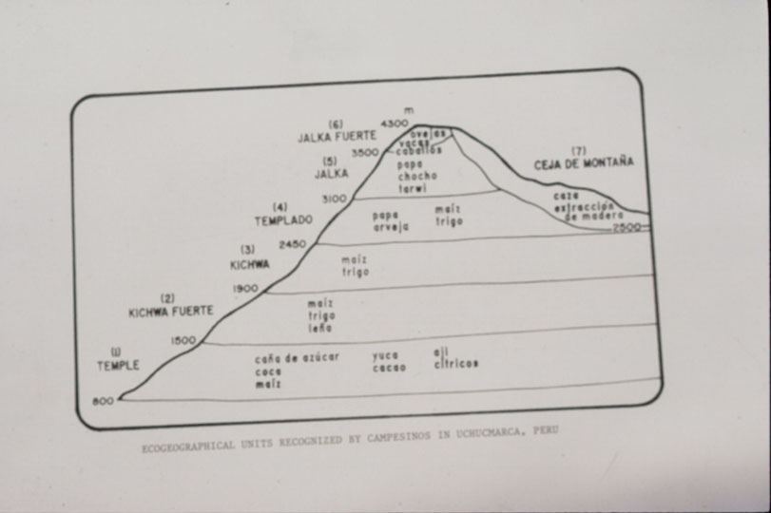
Notes:
1

Slide 2
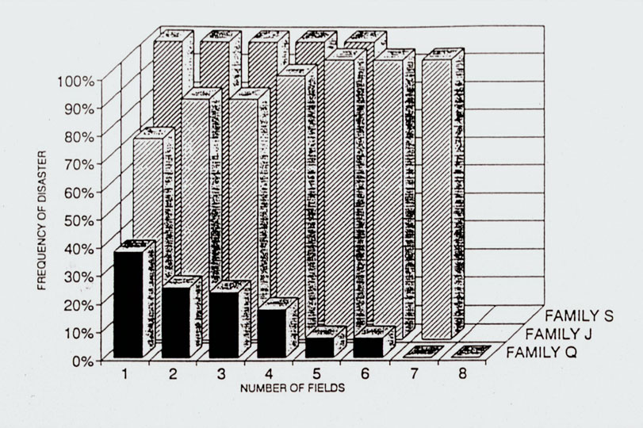
Notes:
2

Slide 3
Andenes : 122, 882 ha - Papa dulce - Oca, Olluco, Mashua - Tarwi

Slide 4
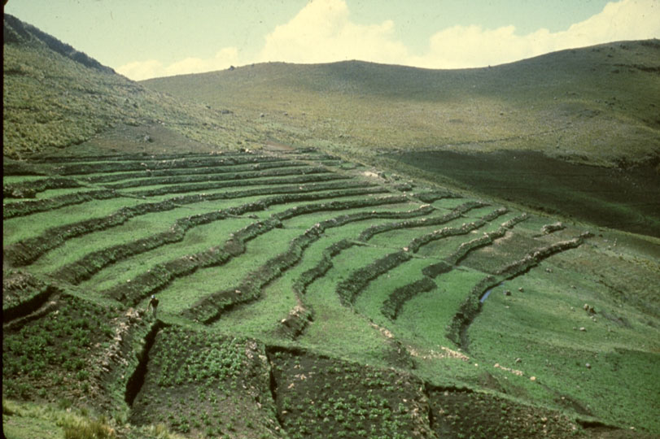

Slide 5
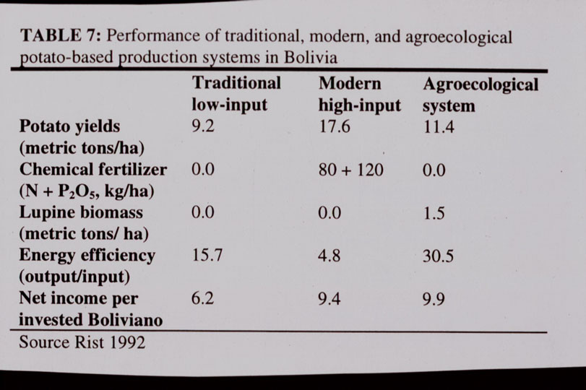

Slide 6
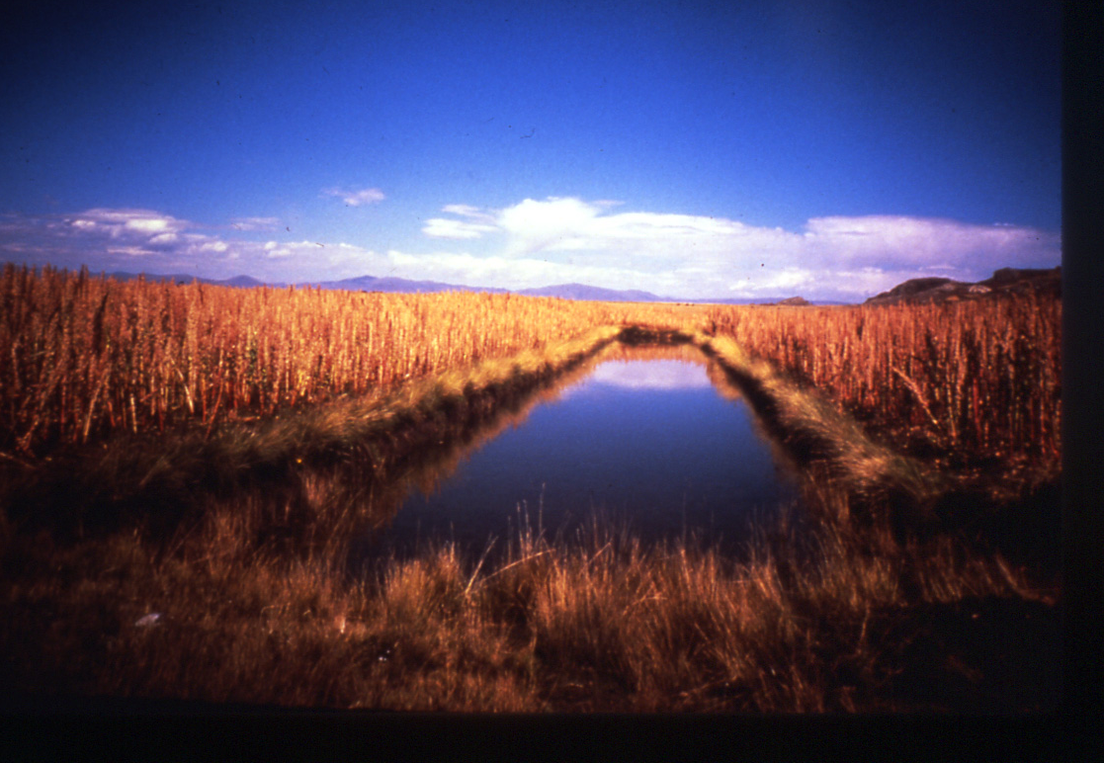
Notes:
6

Slide 7
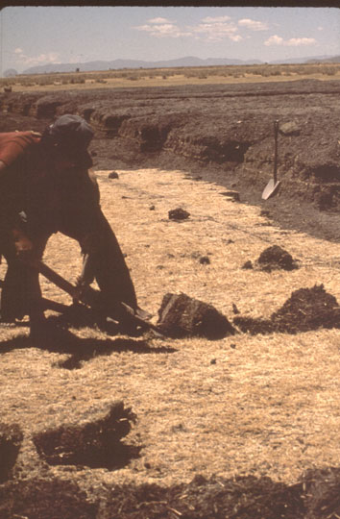

Slide 8
Restos Camellones: 102, 442 has. Recuperados: 4, 720 has

Slide 9
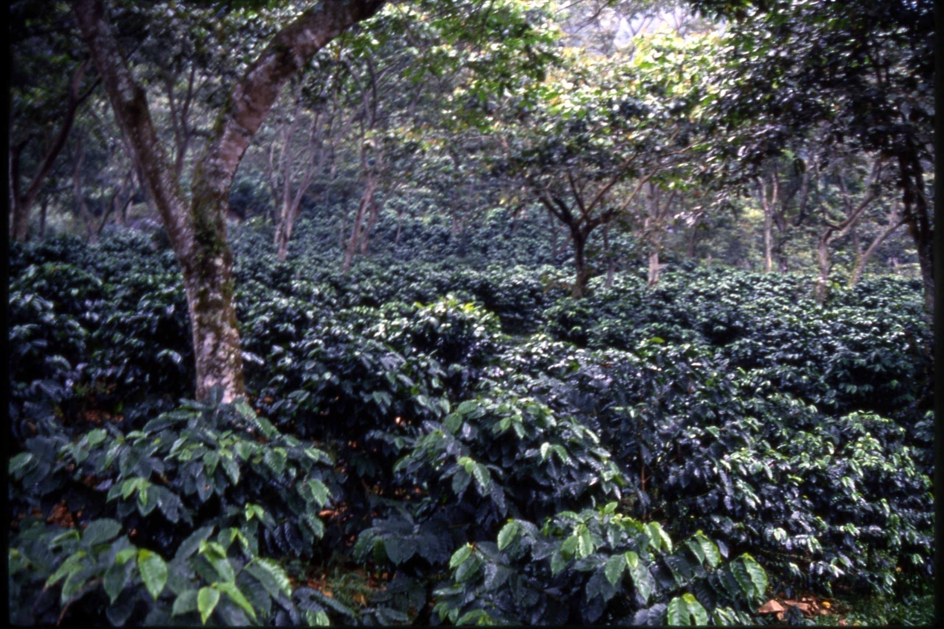
Notes:
9

Slide 10
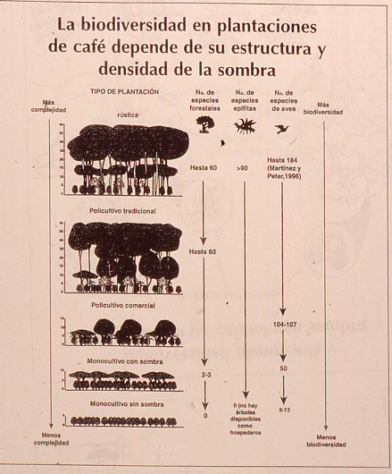

Slide 11
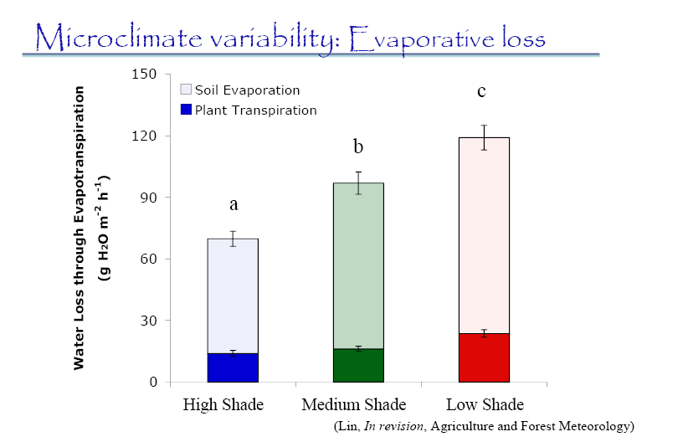

Slide 12
Huracane Ike-Cuba)
Areas under industrial monoculture suffered more damage and exhibited less recovery than diversified farms.
After the hurricane average loss in diversified farms was about 50% compared to 90-100% in monocultures
Productive recovery was about 80 - 90%,and was noticeable 40 days after the hurricane

Slide 13
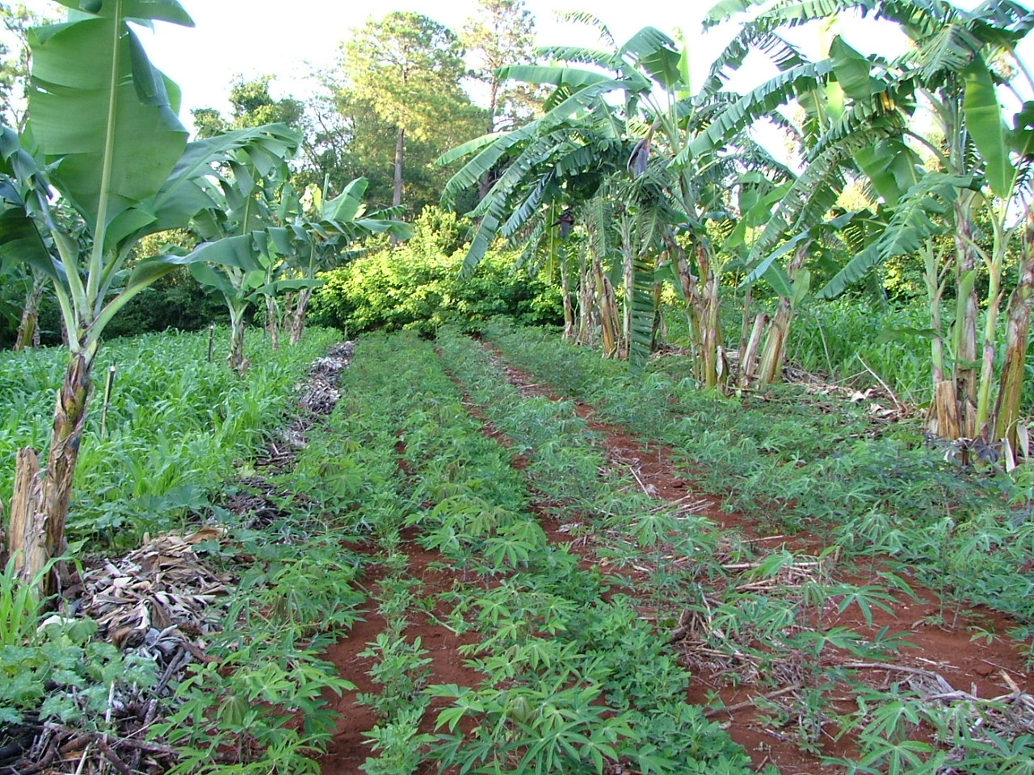

Slide 14
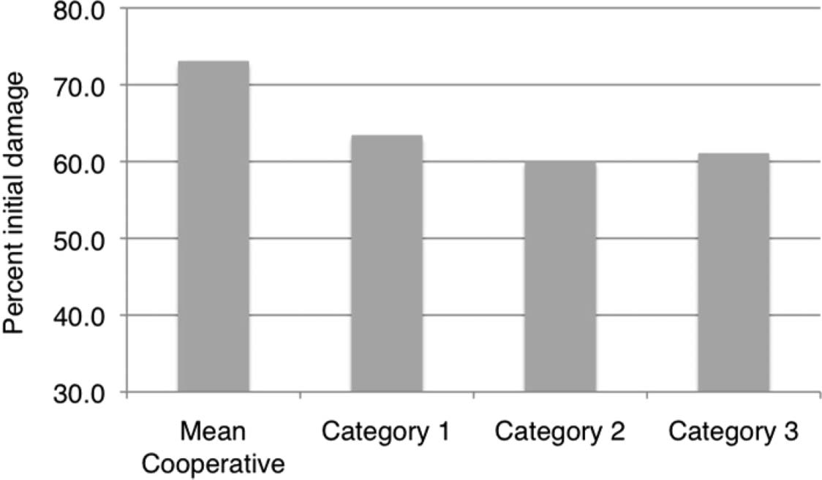
% de dano incial a fincas por el Huracan Ike (2008) la coopertaiva Rafael Zaroza’ en Sancti Spıritus,Cuba, escala 1¼ bajo, 3¼ alto, ) segun grado de integracion agroecologica ( 1 baja, 3 alta).

Slide 15
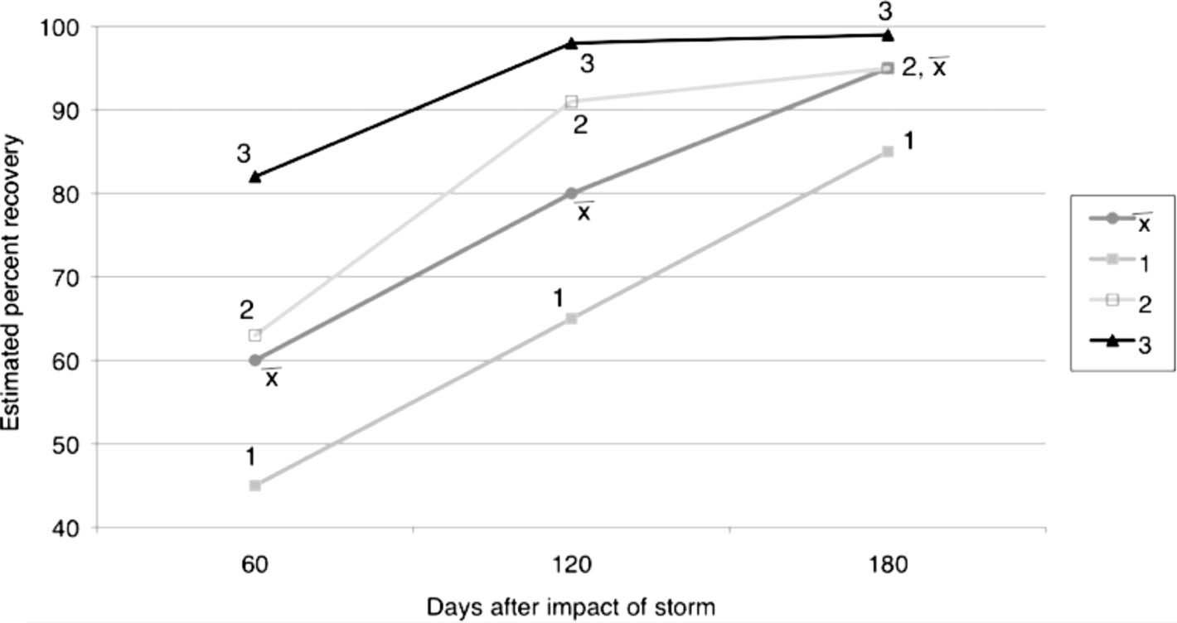
% estimado de recuperacion de fincas a los 60, 120 y 180 dias despues de Huracan Ike (2008) en CCS ‘Rafael Zaroza’ Sancti Spı´ritus segun nivel de integracion agroecologica ( 1 bajo, 3 alto) comparada con el promedio de la cooperativa entera.

Slide 16
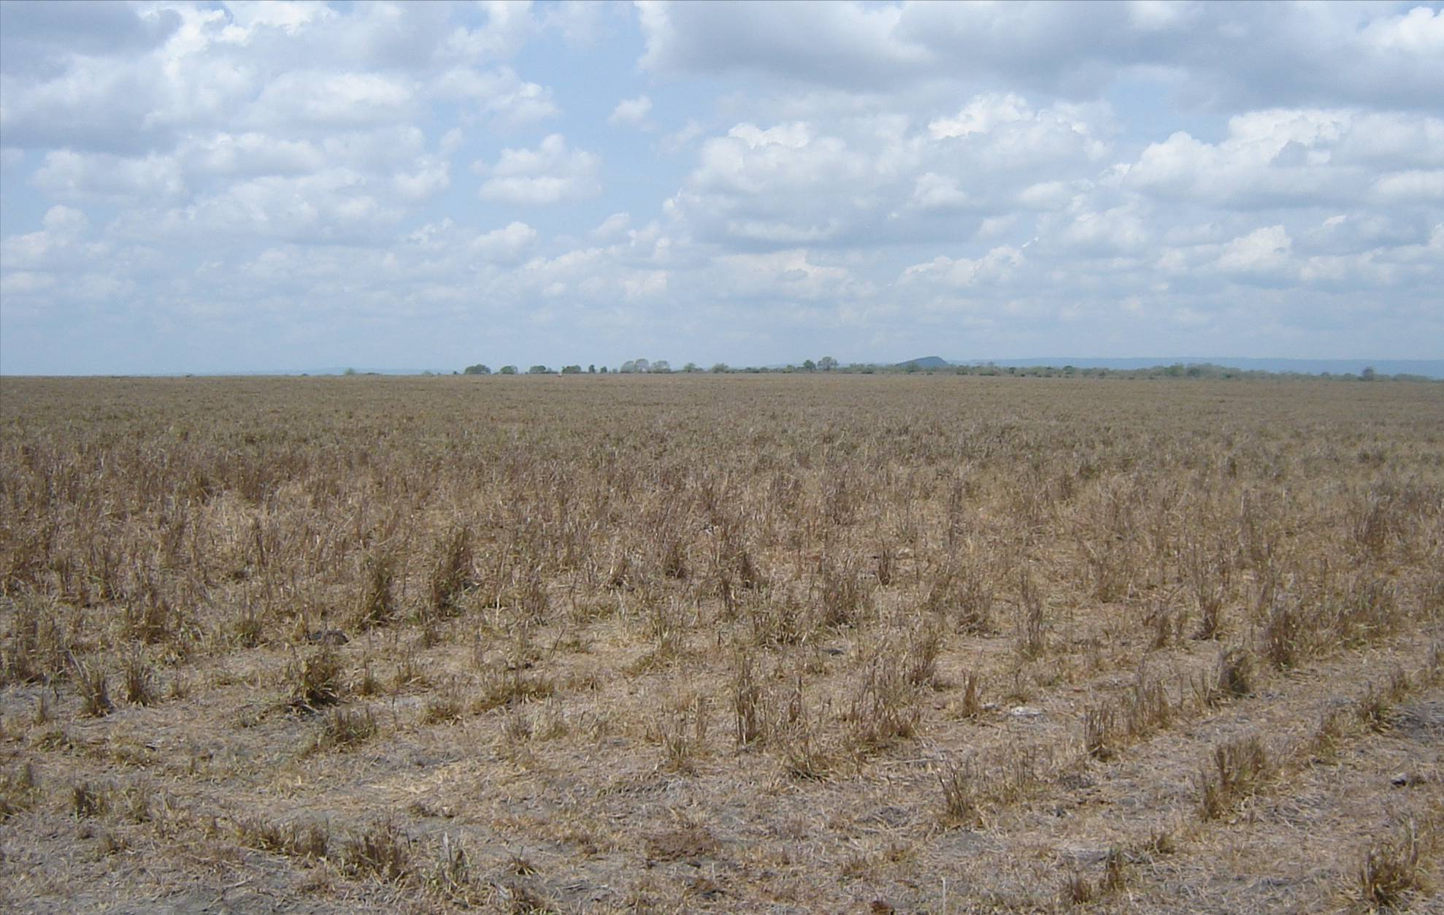
Improved grasses are vulnerable to droughts.
Colombia

Slide 17
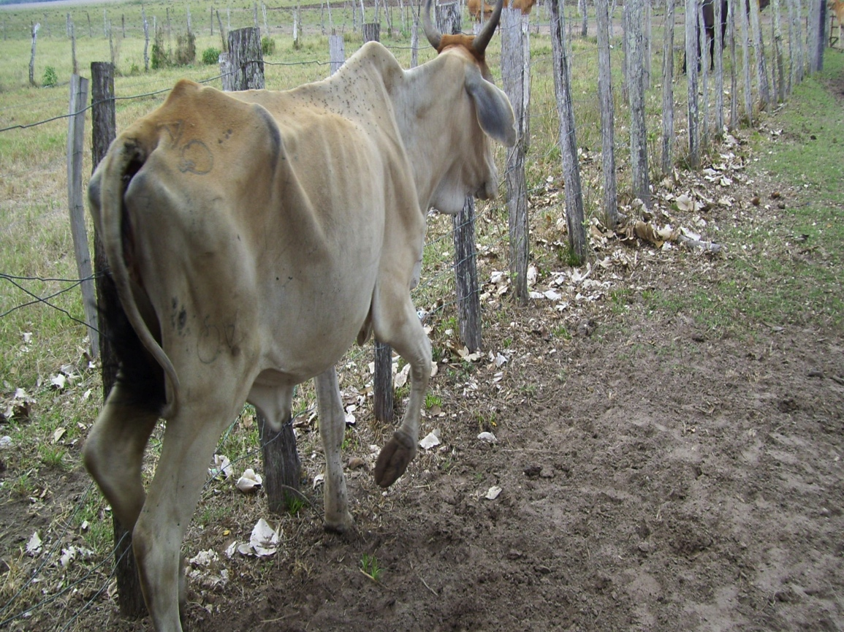
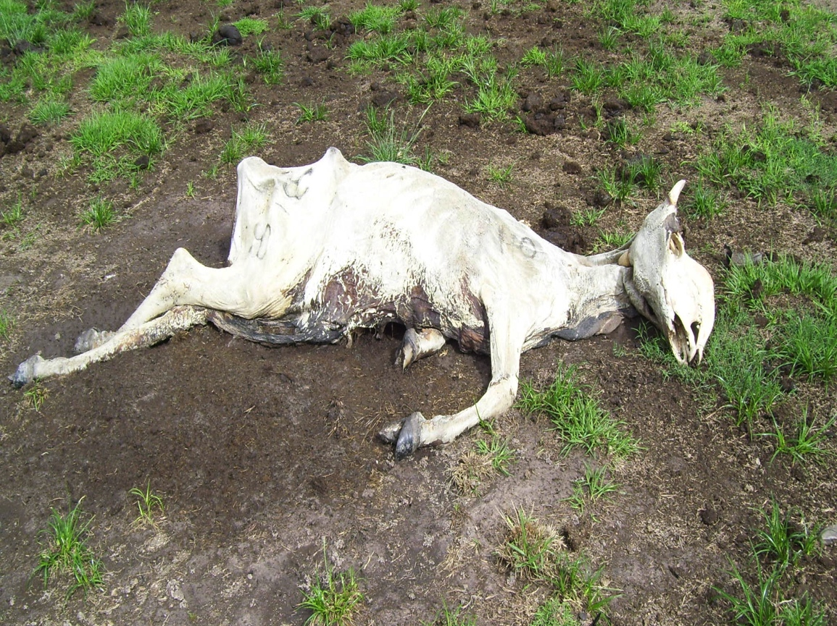
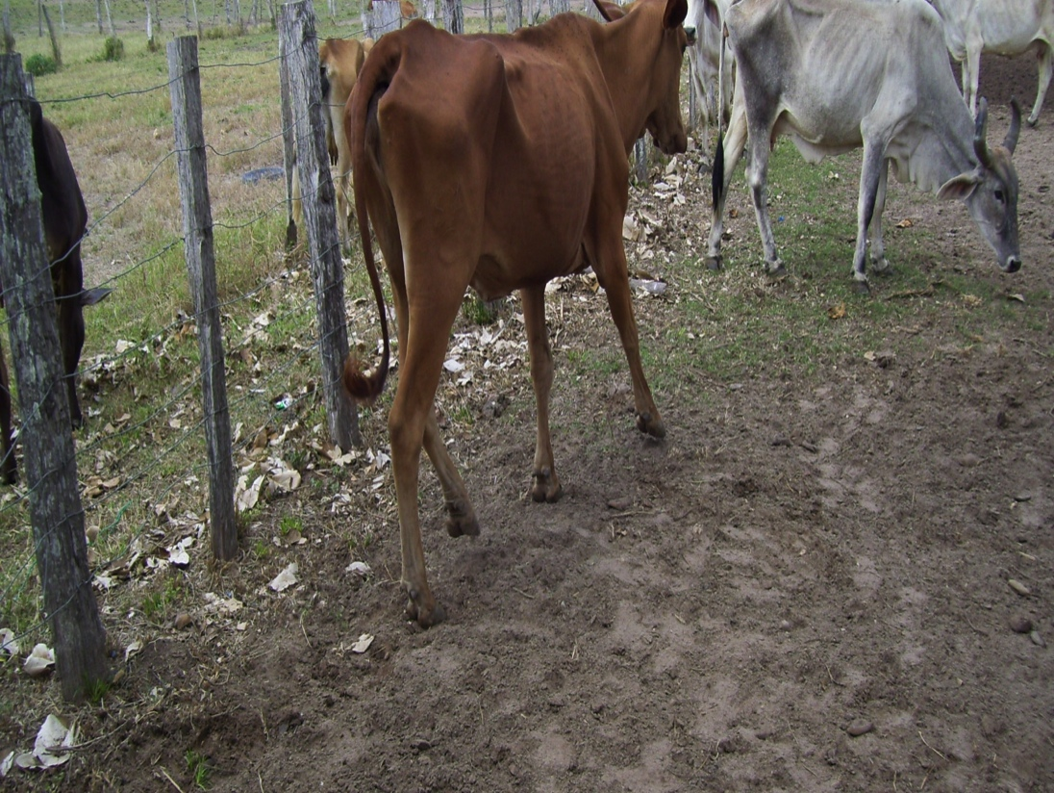

Slide 18
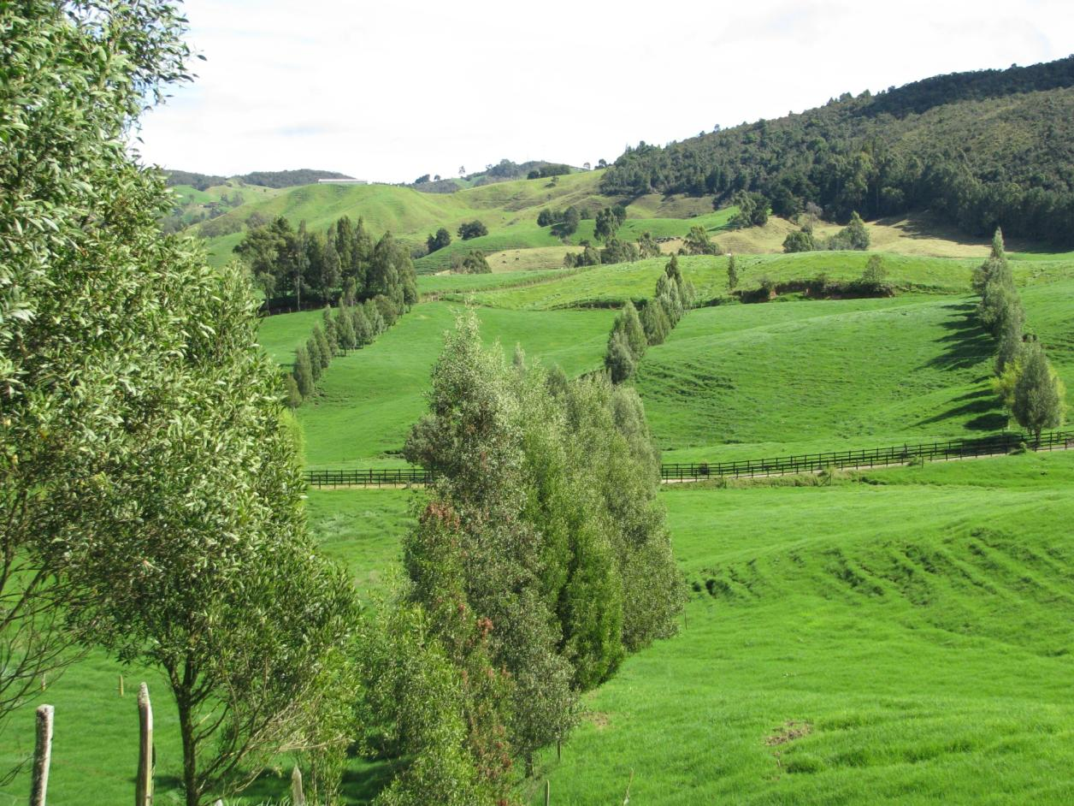
Cercas Vivas

Slide 19
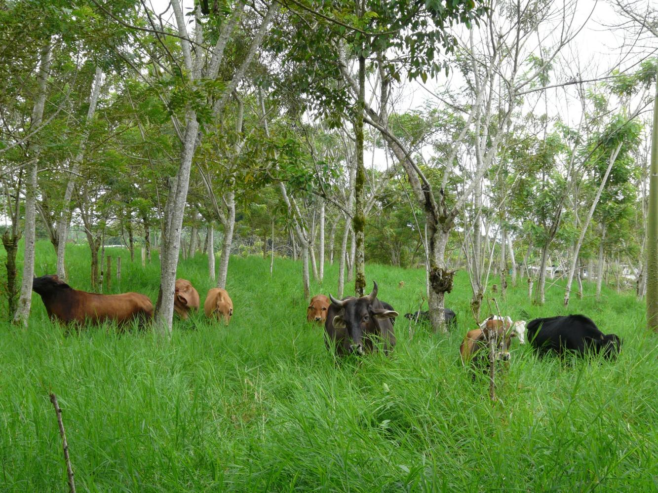
Sucesión vegetal manejada

